Slide 1
PROPOSED SYSTEM
works based on the concept of Internet of Things.
Consists of two microcontrollers : NodeMCU, Arduino UNO
Includes 4 sensors : Atmospheric temperature and humidity sensor (DHT11), pH sensor, soil moisture sensor, light intensity sensor
The output devices used in the project:
3 solenoid valves that are connected to the water tank, alkali tank and acid tank.

Slide 2
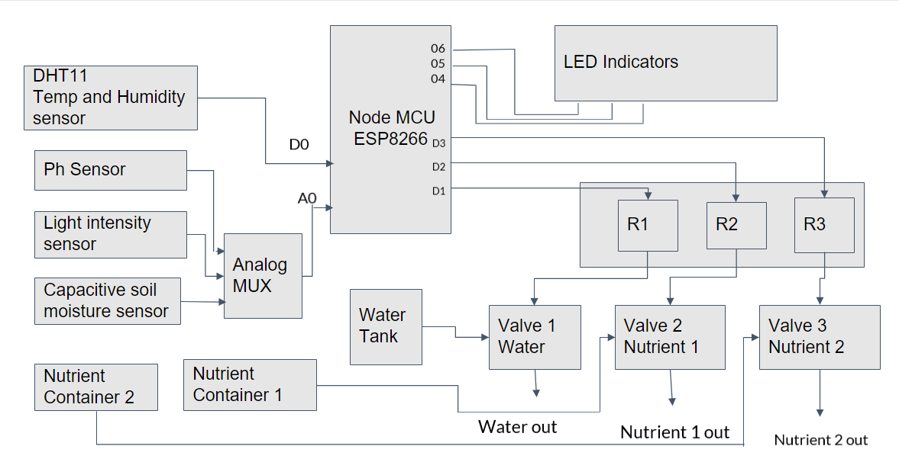
BLOCK DIAGRAM

Slide 3
METHODOLOGY
The sensors will continuously check the soil parameters and are updated in the mobile application.
The device will send notification to the mobile phone if something unexpected happens with the soil.
If the soil moisture is less water will be given to the soil
If the pH is less than or greater than 7, required minerals will be given with water to compromise to the acidic or basic soil characteristics.
This is achieved by setting limits on the threshold values of pH suitable for different crops.

Slide 4
The indicator LEDs will be indicating the different functions being performed by the module
All the data is being sent to the Blynk server and the mobile application will continuously update the parameters according to these data.
The SSID and password of the WiFi is hardcoded to the device
when the device is powered ON, the NodeMCU will check for the WiFi with the same credentials and if it matches, the device will connect to the WiFi.

Slide 5
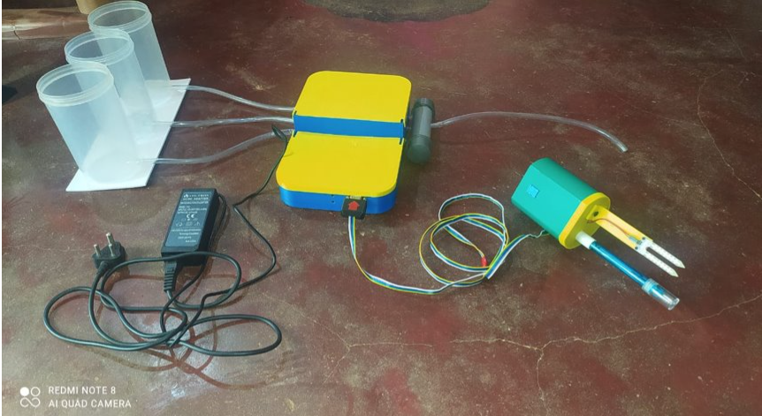
EXPERIMENTAL SETUP Hardware implementation
The hardware setup consists of the following:
Master module
Sensor set
Three containers for water and minerals
A charger for powering the device

Slide 6
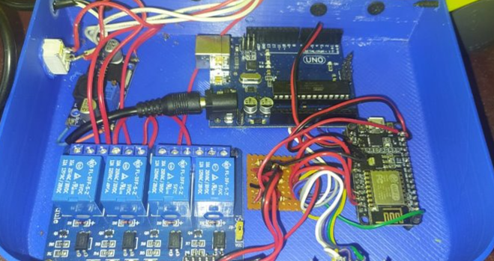
Master module
Master module consists of node MCU, an arduino, relay module and a buck converter
Buck converter- To convert the 14V power supply to 6V
Relay- To control the solenoid valves
Node MCU- provides signals to the relay
NOT gate circuit -To convert high voltage signals from node MCU to low voltage
Sensor set consists of : Moisture sensor, pH sensor, light sensor

Slide 7
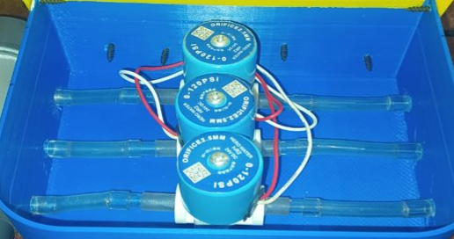
Solenoid Valve
Three solenoid valves are used for letting out water and minerals respectively.
The valve is opened when the relay is turned on and closed when the relay is turned off.

Slide 8
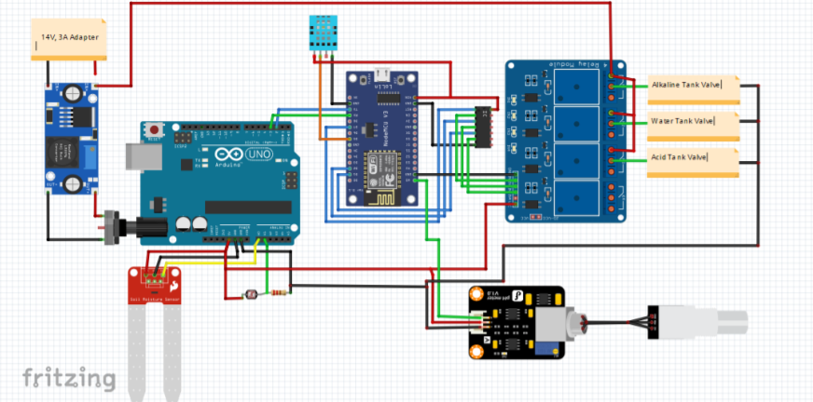
CIRCUIT DIAGRAM

Slide 9
Software Implementation
Mobile Application Creation :
Blynk app is used for its implementation.
This app allows us to create interfaces for our projects using various widgets that we provide.
This app is a well designed interface builder.
Works over the Internet.
Procedure:
Open blynk app> login> click on new project> give name, select device, select connection method> authentication token will be sent to mail> dashboard opens> add widgets, assign pins and variable.

Slide 10
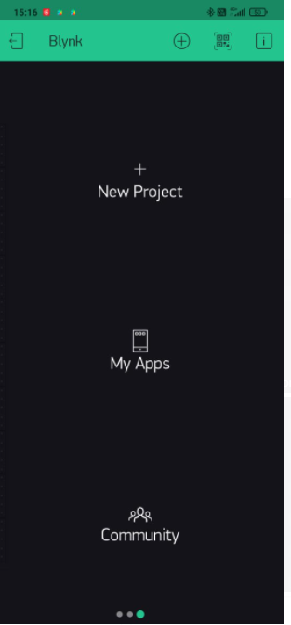
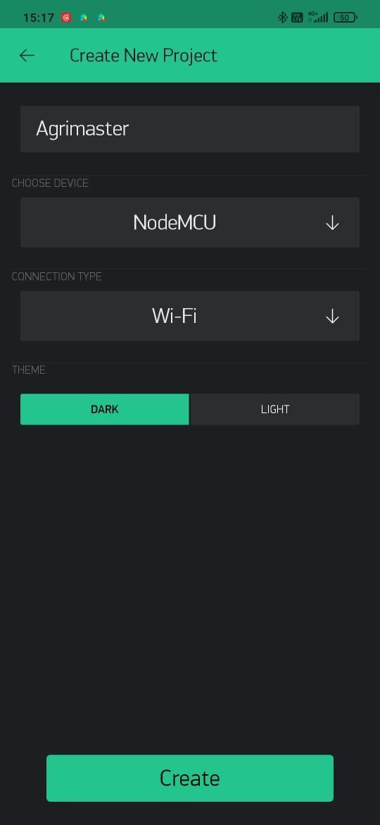
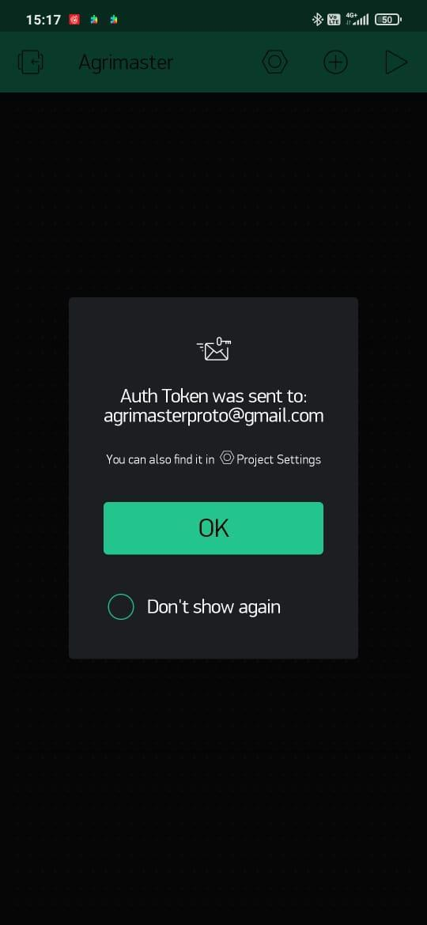
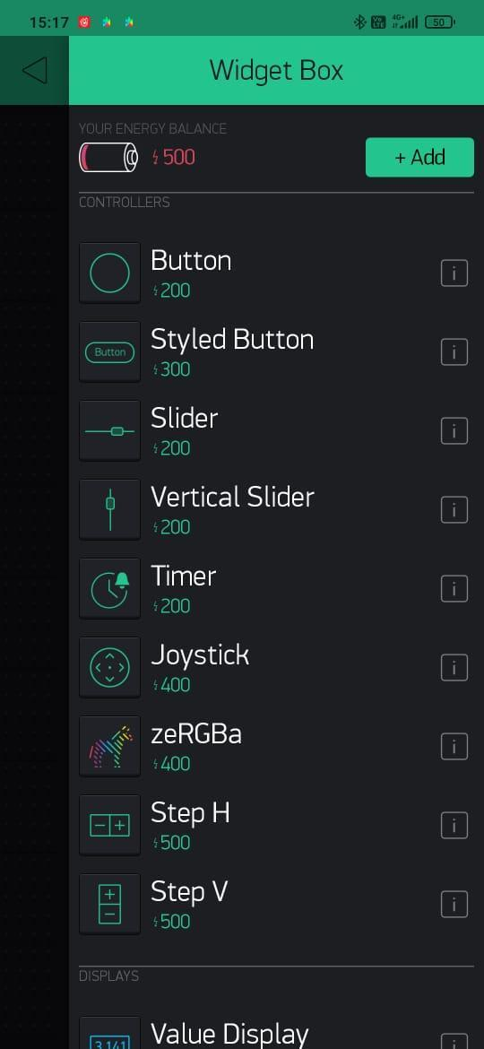
App setup:
Step 2:
Select the device and the connection method
Step 3:
Authentication Token sent to mail
Step 4:
Add the required widgets from the widget box
Step 1:
Click on New Project

Slide 11
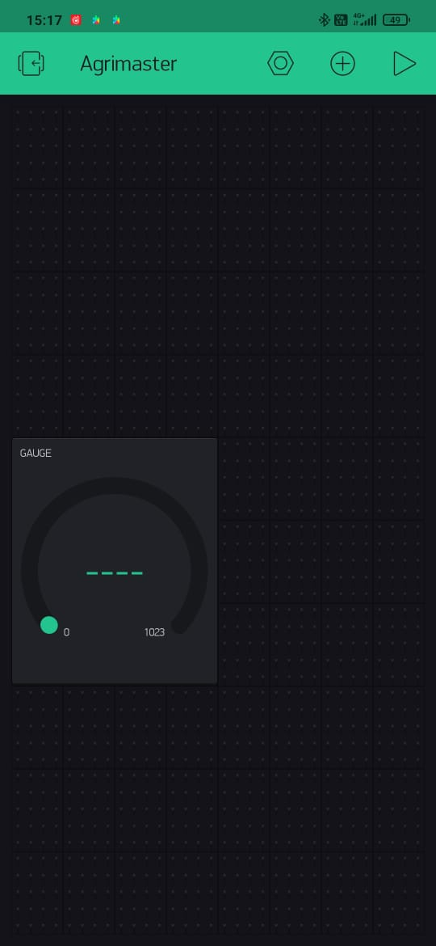
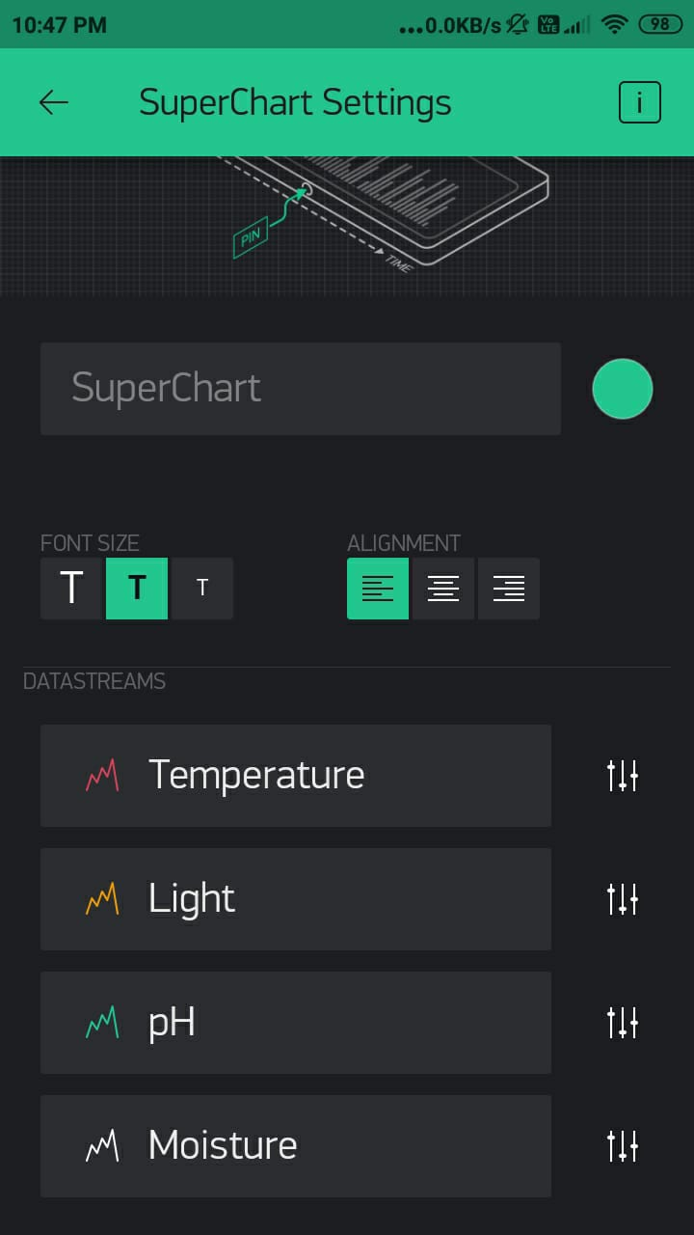
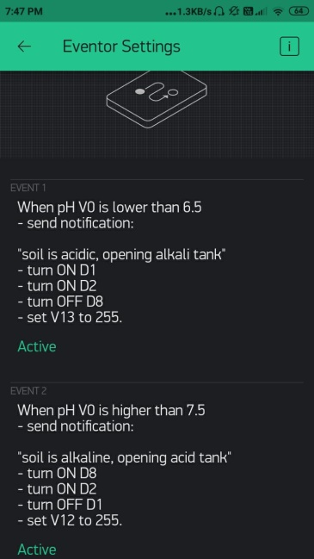
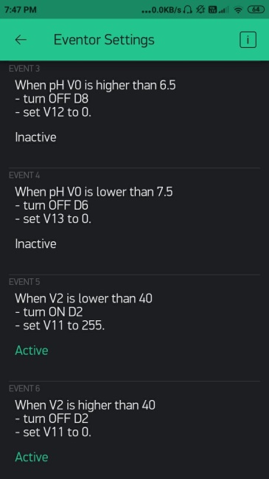
Widgets added:
Six events are added:
Gauge widget is used to indicate moisture and pH level respectively.
Temperature and humidity is indicated using value display widget. The results are plotted in a graph

Slide 12
RESULTS
Hardware Setup Master Module
Solenoid Valve
23

Slide 13
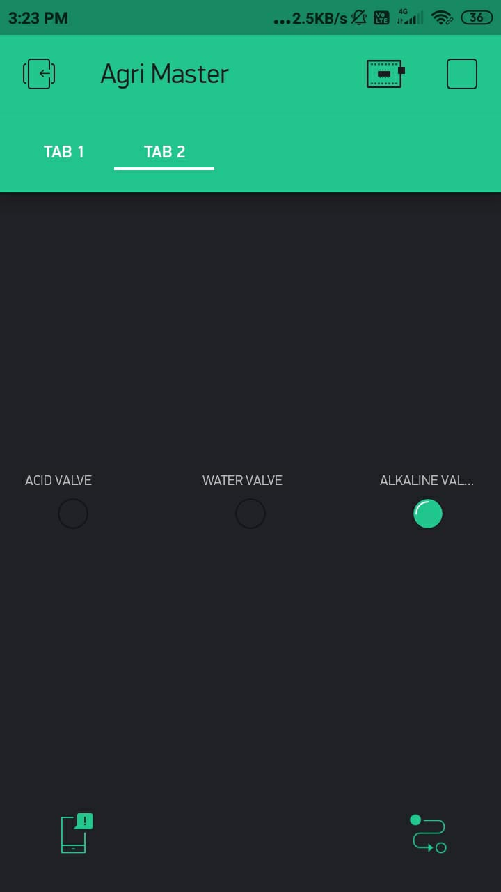
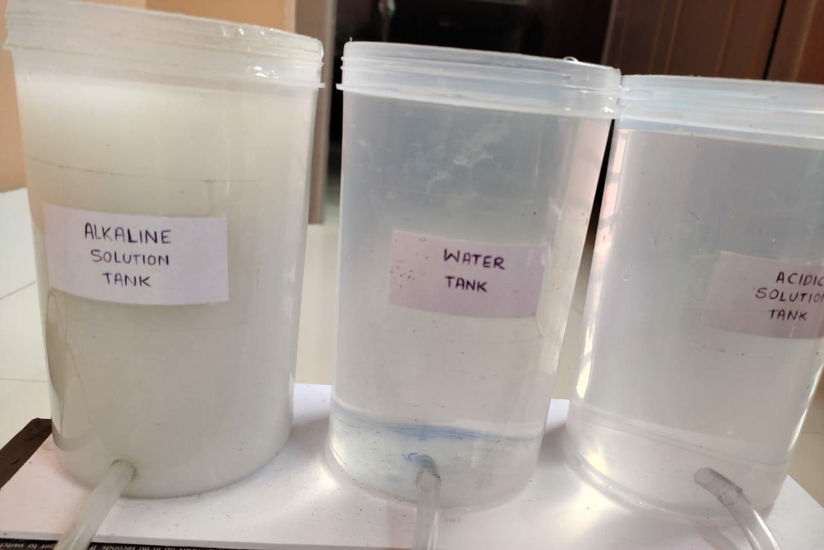
Condition 1: Soil is acidic:
WORKING OF THE SYSTEM BASED ON CONDITIONS
Alkaline solution starts flowing through the pipe
Alkaline tank is open

Slide 14
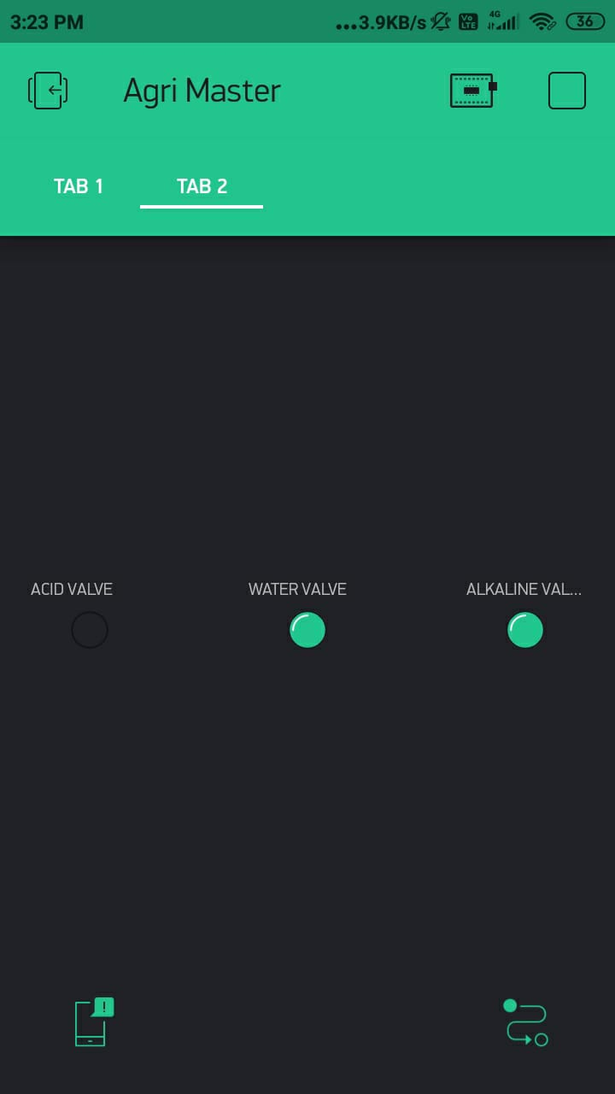
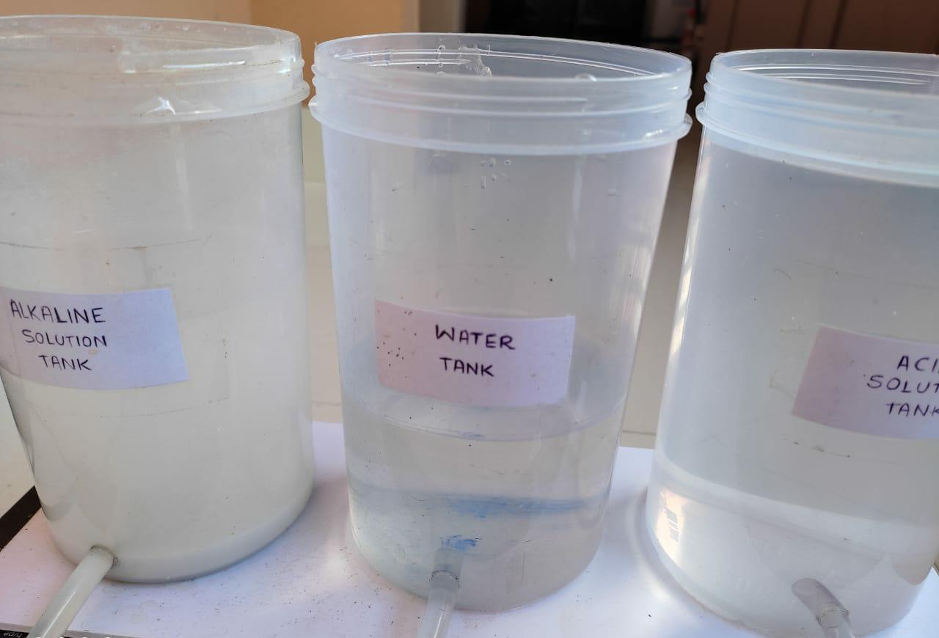
Condition 2: Moisture content in soil is less
Water is also flowing along with alkaline solution
Water valve also gets opened

Slide 15
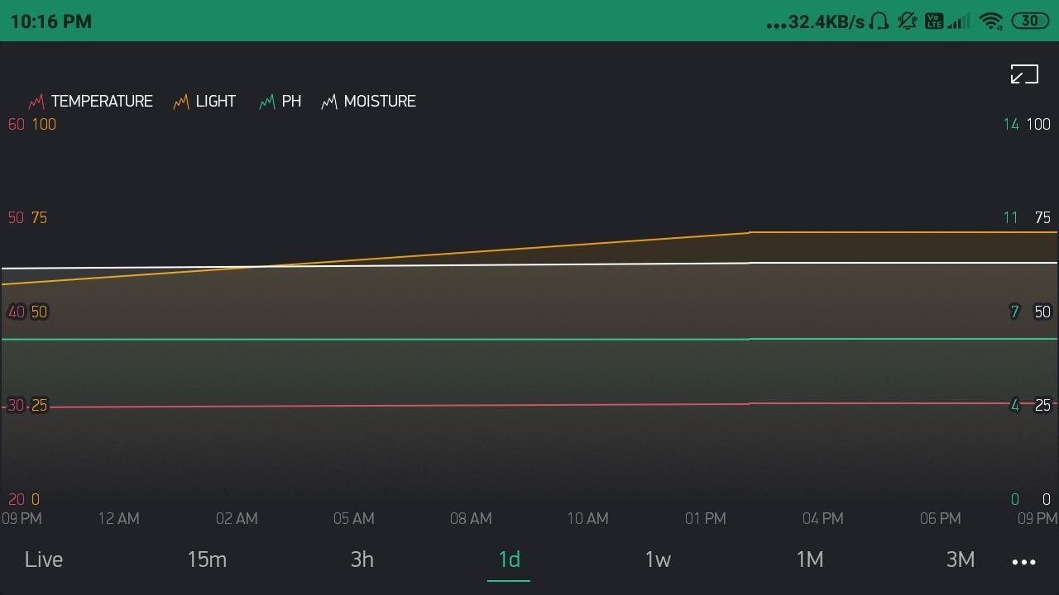
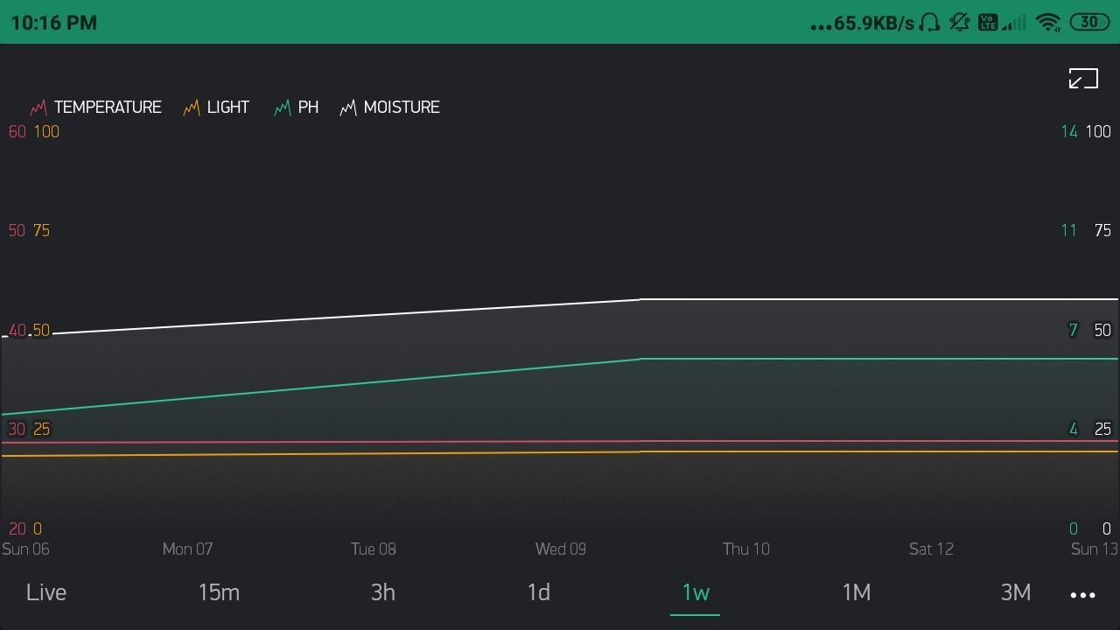
Screenshots of Mobile Application:
Plotting the temperature ,light intensity ,pH and moisture values in graph:
(i) Variations in a day (ii)Range of values in a week

Slide 16
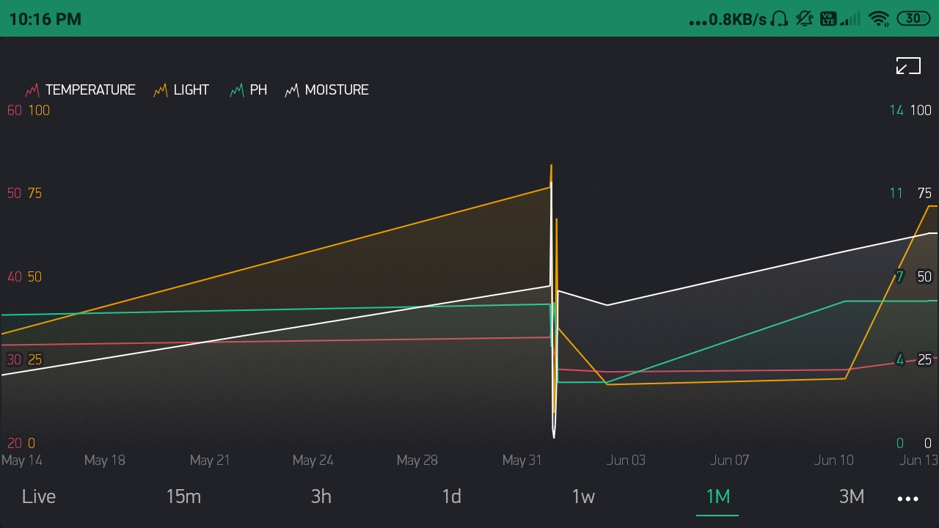
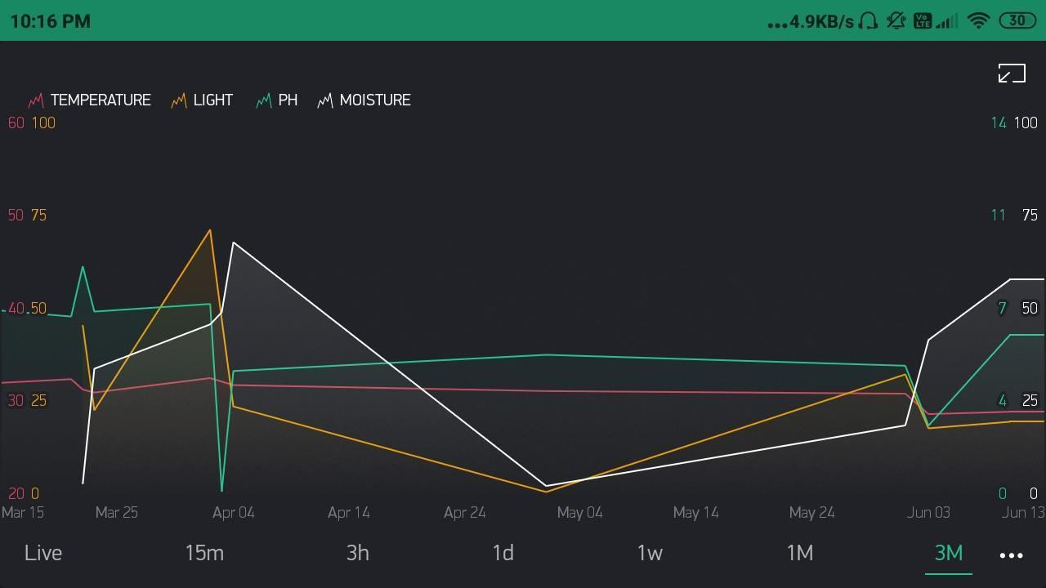
(iv) Range of values over a period of 3 months
(iii) Range of values over a month

Slide 17
CONCLUSION AND FUTURE SCOPE
The system was found to be feasible and cost effective
Reduces the water consumption and power consumption
Minimal maintenance.
The crop productivity increased
This project can be made further more innovative by adding:
controlling and monitoring the sprinkles
checking the faults in the irrigation network and correcting them remotely
visualizing the live working of integrated systems in the field area by pc/mobile
The future aspect of this model can be made into an intelligent system where the system predicts features.
Systems can all be upgraded to Real Time systems

